Slide 1
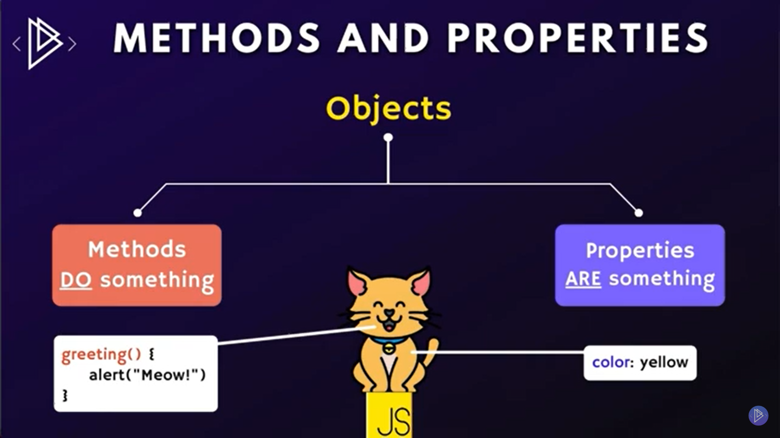
Methods and Properties

Slide 2
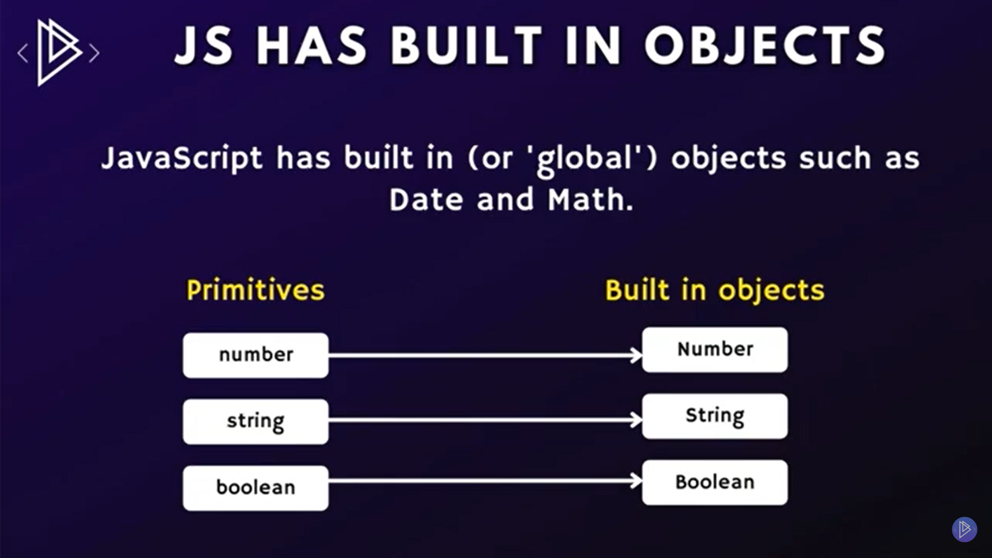
Built in Objects

Slide 3
JS Numbers
isEnteger()
Tofixed()
Toprecision()
Toexponentional
Parseint()
Parsefloat()
toString()

Slide 4
Math Methods
alert(Math.PI * 1)
alert(Math.trunk * 1) remove decimal
console.log(Math.round(2.4)) roundoff
console.log(Math.ceil(2.6)) high
console.log(Math.floor(2.6)) low
console.log(Math.pow(2,3)) power of
console.log(Math.sqrt(2).toFixed(2)) square roort
console.log(Math.abs(-2,4))
console.log(Math.max(-2,4))
console.log(Math.min(-2,4))

Slide 5
JS Strings
Double quotes “”
Single Quotes ‘’
Back Ticks ` `
Use of backslash \’
\n new line
\\ Backslash
\t Tab
Concatentate
Length
Index

Slide 6
String Methods
.length()
.trim()
.toUpperCase()
.toLowerCase()
.indexof()
.lastindexof()
.startwith()
. endsWith()
.includes()
.slice()
.replace()
.charAt()

Slide 7
JS Date Object
let curentDate = new Date();
.getDate()
.getDay()
getHours()
getFullYear()
getMinutes()
getSeconds()
getTime() to get Time Stamp
toLocaleString()

Slide 8
Formats of toString method return values
const date = new Date("2020-05-12T23:50:21.817Z");
date.toString(); // Tue May 12 2020 18:50:21 GMT-0500 (Central Daylight Time)
date.toDateString(); // Tue May 12 2020
date.toTimeString(); // 18:50:21 GMT-0500 (Central Daylight Time)
date.toISOString(); // 2020-05-12T23:50:21.817Z //use at backend in Web
date.toUTCString(); // Tue, 12 May 2020 23:50:21 GMT
date.toJSON(); // 2020-05-12T23:50:21.817Z
date.toLocaleString(); // 5/12/2020, 6:50:21 PM
date.toLocaleDateString(); // 5/12/2020
date.toLocaleTimeString(); // 6:50:21 PM

Slide 9
Thanks!
Do you have any questions?
umairazmat8115@gmail.com
+923217061116 umairazmat.me

